Slide 1


FINAL PRESENTATION
Natural Language Generation (NLG) for Dashboard Analysis Narratives
Computer Practicum
Group 1.
May 2022
Notes:
Good afternoon, Professors
Today we are here to present our project entitled “Natural Language Generation (NLG) for Dashboard Analysis Narratives”

Slide 2
1.Introduction
CESAR
Project Statement Feb 6th.
“Our project will be to create a dashboard utilizing natural language generation to analyze and create a narrative for financial data. Proprietary technology similar to this exists, but there is space for an open-source tool. The goal, therefore, is to create a robust open-source tool that utilizes NLG to summarize financial data visualizations.
Our proof of concept will initially use publicly sourced financial data to create an NLG powered dashboard that consolidates quarterly financial data and displays it in a simple easy to read format.”

Slide 3
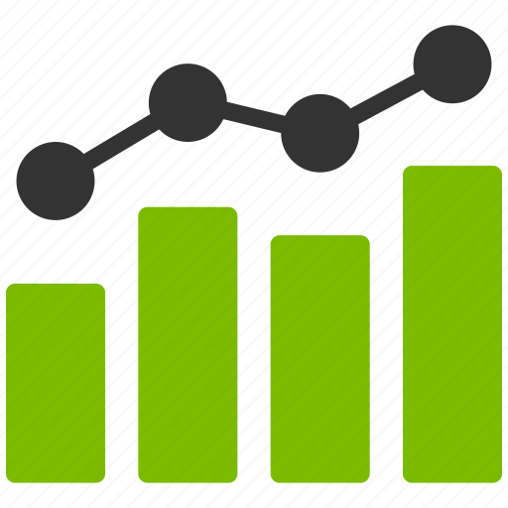
1.Introduction - Objectives
CESAR
Build a visually appealing dashboard.
Visuals and Natural Language narrative update automatically when new data is entered providing the ability to keep up with large amounts of data.
Display graphs and important data (revenue, cost of revenue, net income).
Reports can be accessed at any moment and at any time.
Ability to navigate between provided companies.
-------------
-------------
-------------

Slide 4




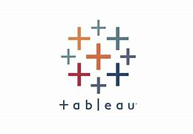


1.Introduction – CLIENT REQUIREMENT FEASIBILITY
CESAR
Although there were no specific client requirements, our group was provided resources that were not used.
Data :
The first resource being the EU Banking dataset. After analyzing the dataset, it was concluded the data was too harsh to fully comprehend and understand. Instead, we opted for a simpler dataset that would allow us to put more focus on the NLG components.
Technical resources
Next our group chose to focus on Tableau as a local instance rather than AWS. Processing power local as AWS was deemed to be too costly.
Lastly our group initially analyzed Power Bi applications and integration; however, after further analysis found we could not obtain a license to use desired applications

Slide 5
2.DATA & Analysis
ROBERT
The data source that will be used for this project is Microsoft yearly financial data. Collected directly from yearly “10K” reports available on Microsoft's website. In addition, we implemented Apple data to show proof of concept with multiple companies.
We have allocated 3 years of data from the balance sheet, income statement, and the stock price that will be used to develop the dashboard for our project.
We have chosen to use Microsoft and Apple data due to there being over ten years of data publicly available and the data is relevant to the project.
Additionally, both of their financial statements follow Generally Accepted Accounting Practices (GAAP) allowing us to utilize the dashboard and NLG on additional companies that follow the same standards

Slide 6
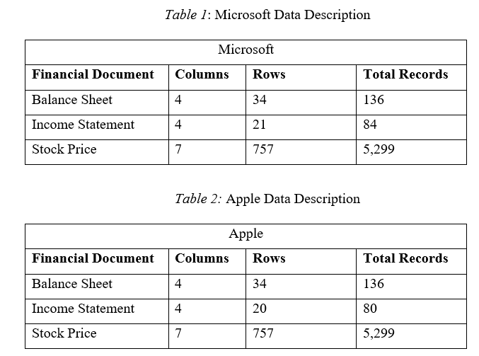
2.DATA & Analysis
ROBERT
The following describe the primary variables each financial document is comprised of:
The primary variables in the balance sheet are total assets, total liabilities, and total stockholders’ equity which represent the value of the company.
The primary variables on the income statement are total revenue, cost of revenue, net income, and diluted eps. These represent the sales and income of the company.
The primary variable on the historical stock price is the close which represents the value of one share of Microsoft/Apple at the end of each day.

Slide 7
2.DATA & Analysis
ROBERT
The preprocessing steps used on the financial data followed the normal steps of data preprocessing which includes data cleaning, data transformation, data reduction, and quality assessment.
The first step was to start by exporting the balance sheet and income statements from the “10k” report excluding all other financial data available. Making each of the reports its own file.
Then unmerging cells and removing blank lines to format the reports so that they are readable and importable into Tableau. Followed by combining multiple years side by side.
Then using Tableau to create each graph and combine them on a dashboard.

Slide 8
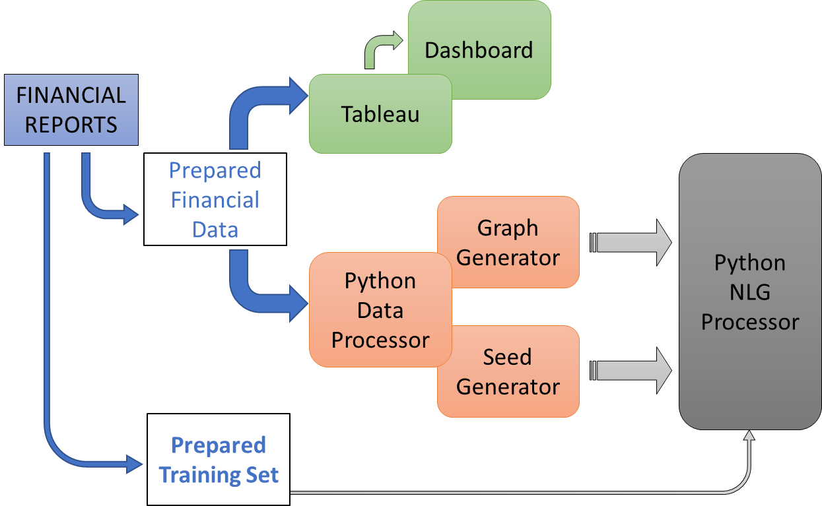
3.PYTHON NLG & RNN MODEL INTEGRATION
BRADEN

Slide 9
3.PYTHON NLG & RNN MODEL INTEGRATION
BRADEN
We investigated/coded/implemented using either an LSTM (Long Short-Term Memory) or an RNN (Recurrent Neural Network) to be the NLG machine learning model. We have run a few tests on both LSTM and RNN and the results of the RNN seem to be a better fit for our project.
Below is a sample output from an LSTM model and the bold sentence is the random seed from the text:
“LSTM Output: if he's going to experiment let him. But I told this guy, "You can't” tou the wou aan to the wou aan to the wou aan to the wou aan to the wou aan to the wou aan to the wou aan to the wou aan to the wou aan to the wou aan to the wou aan to the wou aan to the wou aan to the wou aan to the wou aan to the wou aan to th”
The RNN which takes longer to train provides text that is more understandable. The RNN was easier to save and reload without errors or issues on the backend. In almost all areas the RNN was seen as more valuable which is why it was used going forward.
RNN Configuration (256 Embedding Dimension and 2048 RNN/GRU Units)

Slide 10
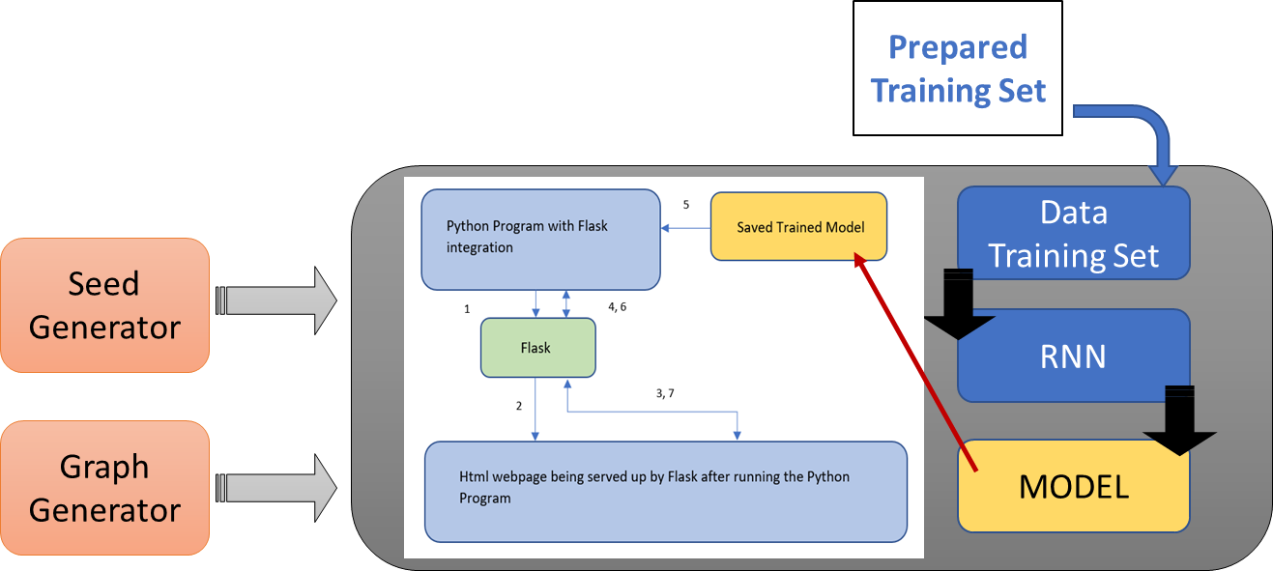
3.PYTHON NLG & RNN MODEL INTEGRATION
BRADEN

Slide 11
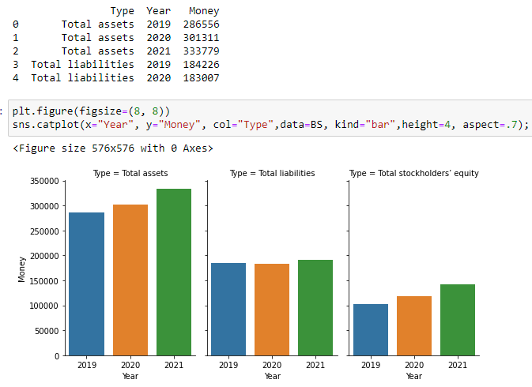
3.PYTHON NLG & RNN MODEL INTEGRATION
BRADEN

Slide 12
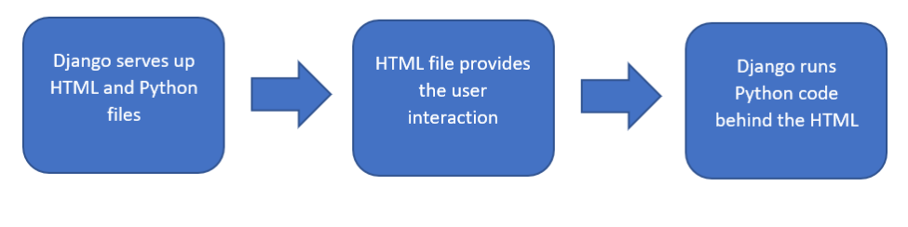
3.PYTHON NLG & RNN MODEL INTEGRATION
CONRAD
Flask Integration
After careful examination and further research, the decision to move to another python-html integration library was made.
The library used for the new implementation is known as Flask.
Using Flask was much more streamlined and only required minor changes to the project directory. It also allowed for a cleaner Project directory allowing for fast implementation and a much more streamlined integration

Slide 13
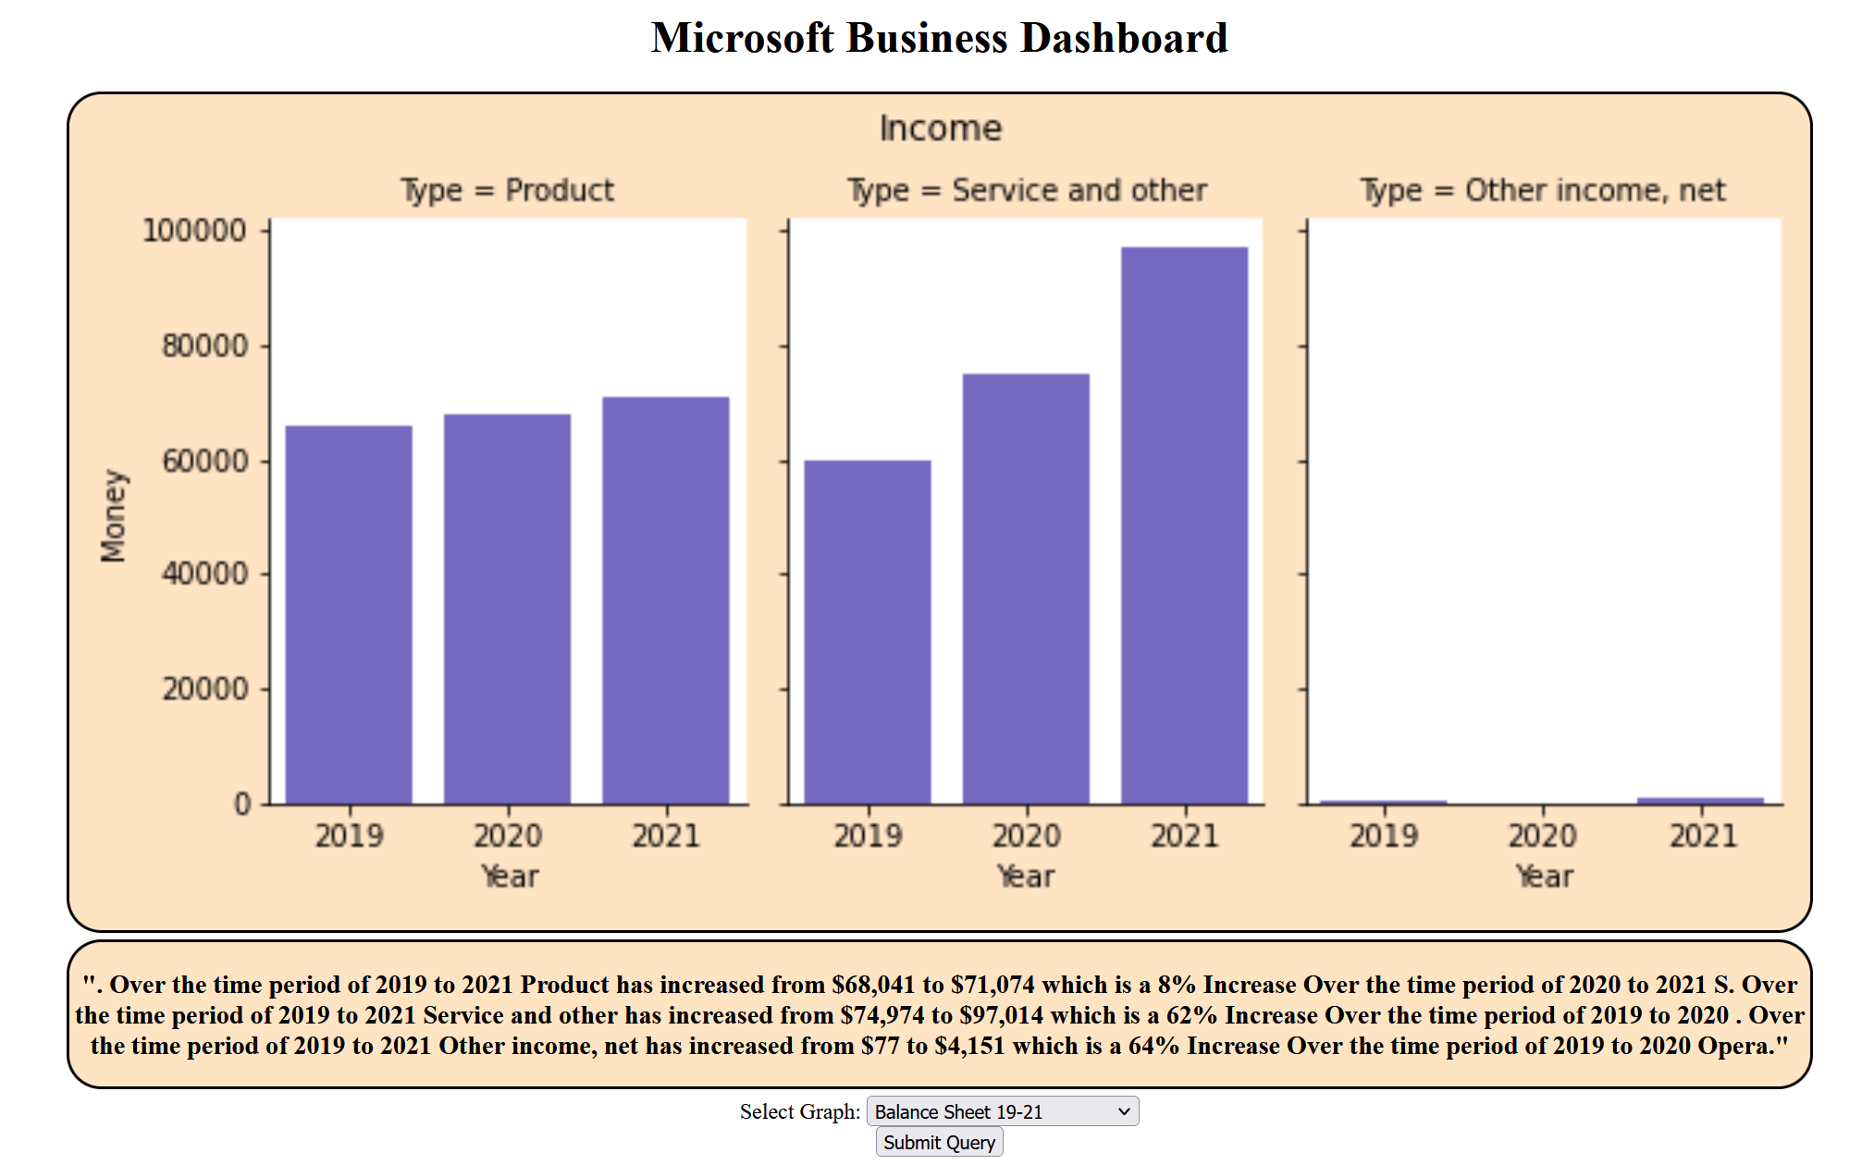
3.PYTHON NLG & RNN MODEL INTEGRATION
CONRAD

Slide 14
3.PYTHON NLG & RNN MODEL INTEGRATION
CONRAD
LIVE DEMO PART 1
WITHOUT TABLEAU

Slide 15
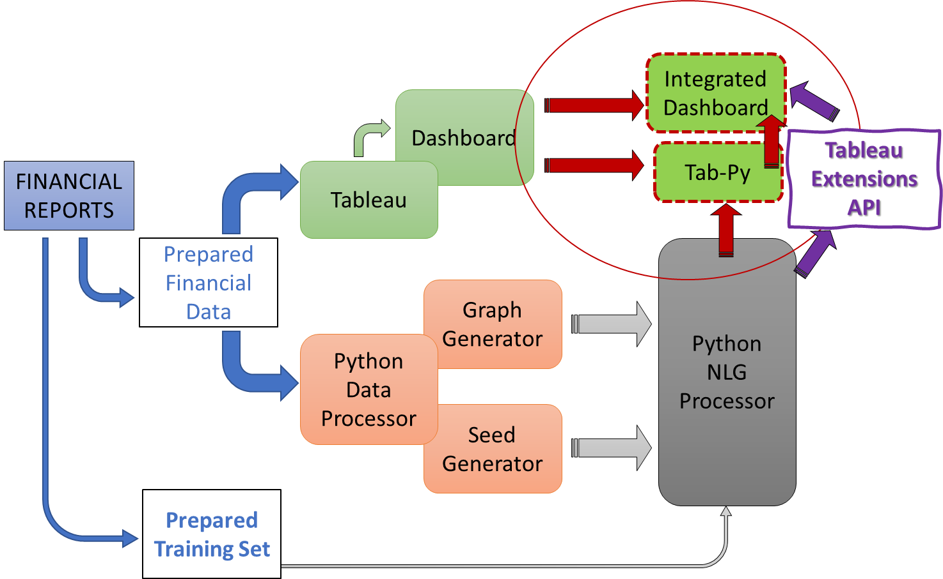
4.Tableau INTEGRATION
CONRAD

Slide 16
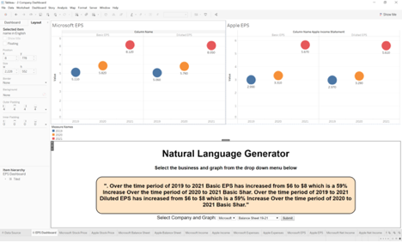
4.Tableau INTEGRATION
CONRAD
LIVE DEMO PART 2
WITH TABLEAU

Slide 17


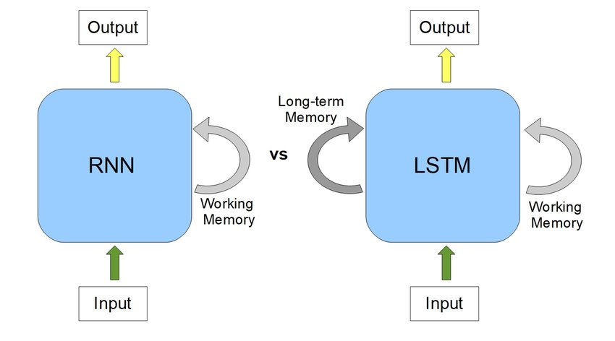
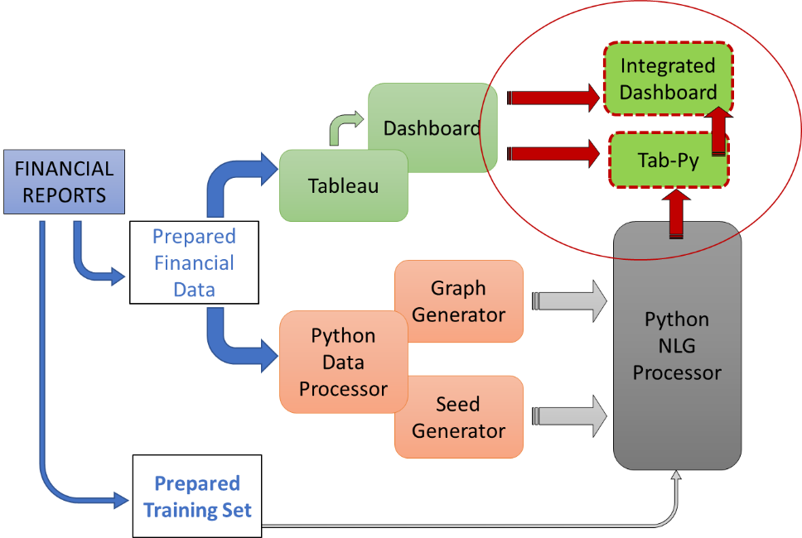
5.CONCLUSION - Overview
MICHAEL
Initially trained the model on shareholder's letters before creating a training set using the financial data. After adjusting, the Python data processor was able to consistently provide legible and accurate results.
Although the plan was to initially not integrate the python processor into Tableau due to time constraints, our group was able to fully integrate the NLG component into a Tableau dashboard. The python data processor was integrated using a Tableau extension providing a more automated system.
Microsoft data initially processed for utilization with later addition of Apple data.
We ran tests evaluating both an LSTM model vs. an RNN model and concluded the RNN model was more accurate amongst other benefits.

Slide 18
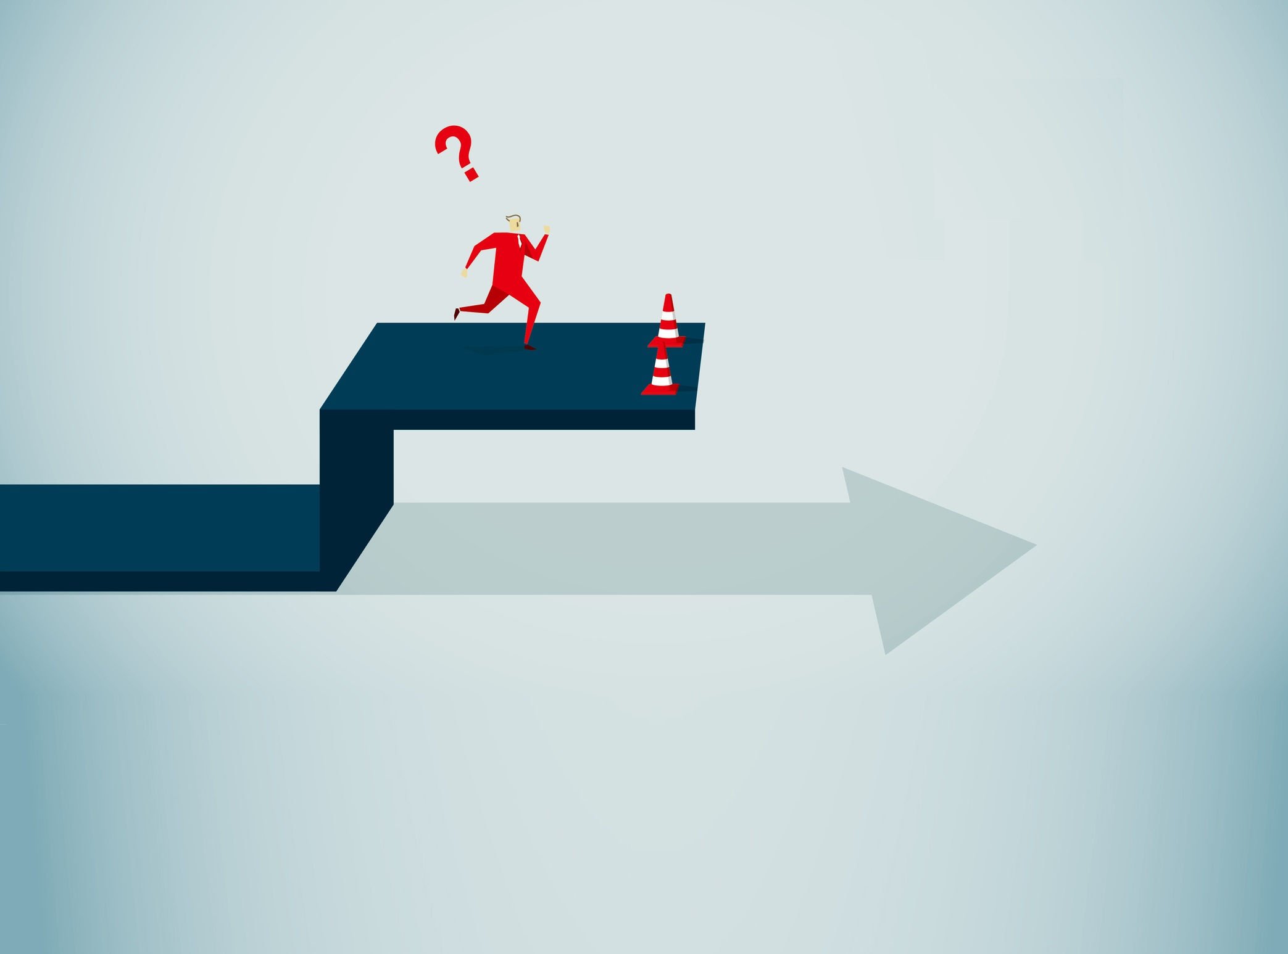
5.CONCLUSION - Limitations
MICHAEL
The first limitation is that the model is trained on Microsoft and Apple data.
Next, there is a text description for only one company.
More data could create a more robust model as well as help finish sentences at the desired location.

Slide 19
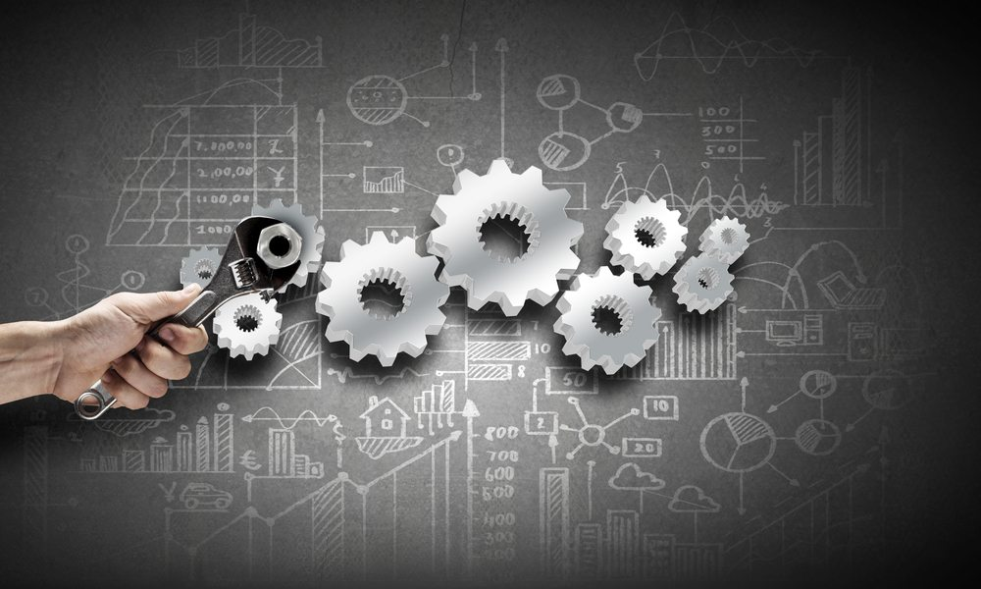
5.CONCLUSION - improvements
MICHAEL
Another improvement could be the automation of data processing. Now, our solution requires a specific format for financial documents, in the future, machine learning could be used to automatically process various documents.
Expansion on the current NLG approach with a more robust model trained and operated on significantly more robust hardware. For example, Using AWS or GCP cloud instances to have access to Nvidia A100s or similarly spec’d GPUs.
Further augmentation tactics may explore adding additional phrases to our list of current phrases and the possible shuffling of each of the phrases. This may increase the training time but may also lead to a more applicable model.

Slide 20


Thank you!

